Slide 1
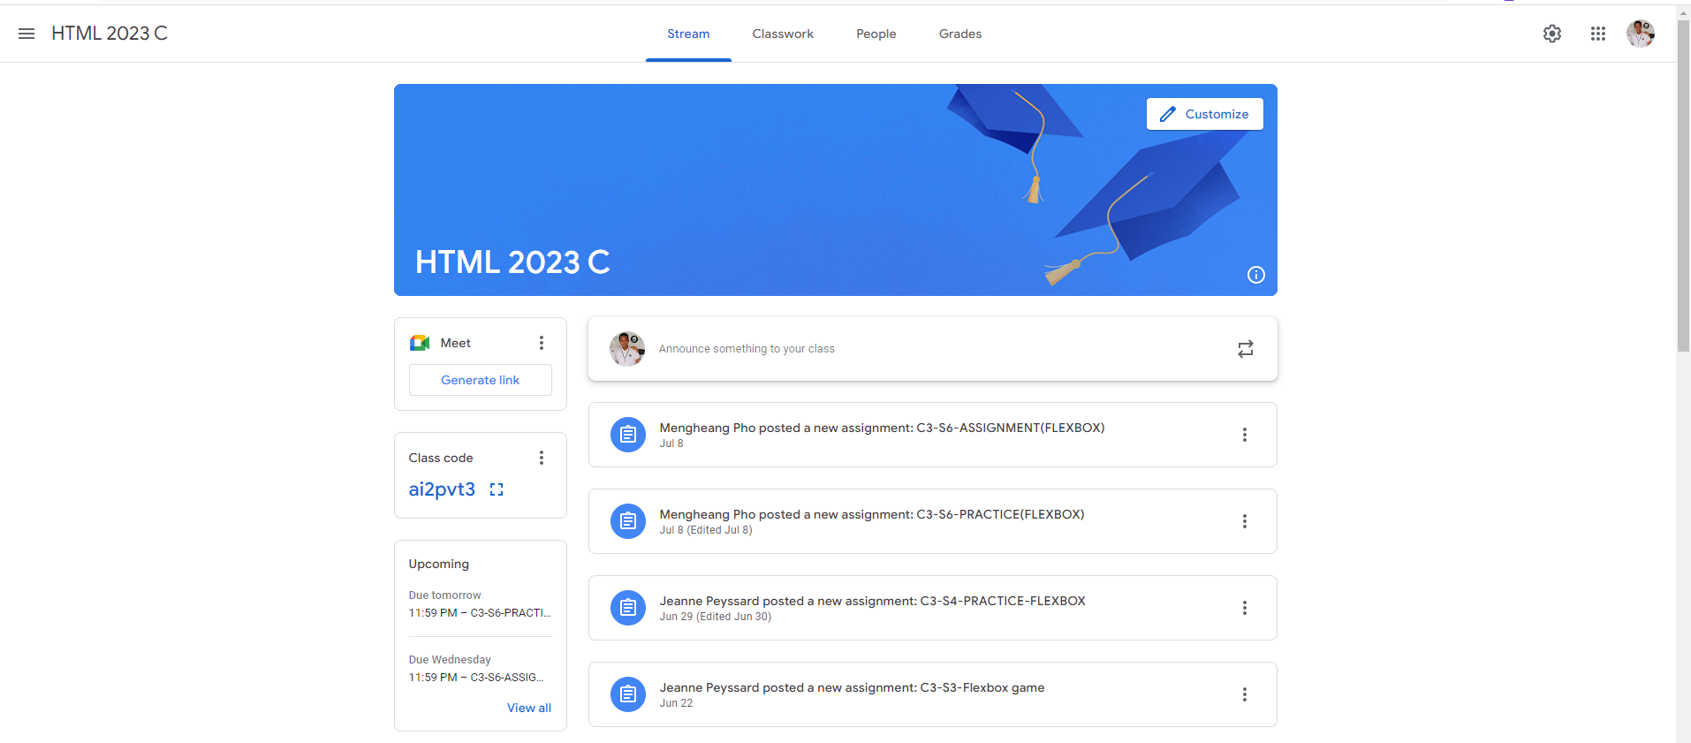
Identify root components of website below

Slide 2
Flex-direction: column;
nav
Flex : 0
main
Flex : 1

Slide 3
Navegation| step1
div1
div2
div3
Flex-direction: row;
Justify-content: space-between;

Slide 4
Navegation| step1
icon
text
text
text
text
text
icon
icon
icon
Flex-direction: row;
Justify-content: flex-start;

Slide 5
Main| step1
Header-main
Content-main

Slide 6
Header-main| step1
icon
text
Flex-direction: row;
Justify-content: space-between;
Align-self: end;

Slide 7
Content-main| step1
Flex: 0
Flex: 1
Sidebar-left
content
Flex-direction: row;

Slide 8
Content-main| step1
Sidebar-box
box
box
Flex-direction: column;
Justify-conten: space-evenly;
Sidebar-box
box
Sidebar-box
box
box

Slide 9
Sidebar-left| step1
logo
icon
Button-link
title
icon
title
text
text
View-button

Slide 10
icon
text
icon
Flex-direction: row;
Justify-content: space-between;

